Slide 1

Introduction to Physics II
(Spring Semester 2019)
Course Information
Department of Physics, School of Natural Sciences, Shiv Nadar University

Slide 2
Course Title: Introduction to Physics-II
Course Code: PHY102
Course credits: 5
(3 lectures+1 tutorial +3hr lab)
“This is a continuation of PHY 101 meant for engineers and non-physics majors. The course will introduce students to Electricity and Magnetism, Maxwell’s equations, light as an electromagnetic wave, and wave optics.” (Physics-UG-Prospectus, SNU)
Prerequisites (a must): MAT101, PHY101

Slide 3
Course Title: Introduction to Physics-II
Course Code: PHY102
Course credits: 5 (3 lectures+1 tutorial +3hr lab)
Lectures: Monday, Wednesday, Friday (10:00 – 10:55 AM)
Venue for lectures: B315
Tutorials: Tuesdays, Thursdays (5:00 – 6:00 PM)
Venue for tutorials: D022, D026, D122
Check time-tables of tutorial classes for various groups for time slot and venue.
Labs: Monday (2:00-5:00 PM), Wednesday (2:00 – 5:00 PM)
Venue for labs: A-wing (A101), First floor, Physics lab

Slide 4
Academic aims and learning outcomes
During the semester we aim:
• to teach a wide range of physics at a basic level, appropriate to the first year of a physics degree.
• to stimulate the interest of students in physics by exposing them to some of the issues at the frontiers of knowledge.
• to allow all students, independent of their entry attainments, to reach a similar level of understanding in physics, with the necessary skills in mathematics to solve simple problems in physics.

Slide 5
On completion of the course, students should be able to:
• recognise the fundamental physics in a wide range of physical processes.
• explain a wide range of physical processes from underlying basic principles.
• explain the interrelationship between some physical parameters.
• calculate or estimate solutions to some simple physical problems.

Slide 6
Organization and Communication
Course Instructor:
Dr. Bhaskar Kaviraj
Office: A017C (A-wing, Ground floor)
Email Address: bhaskar.kaviraj@snu.edu.in
There is a committee comprising of the course instructor, the UG advisor (Dr. Samarendra Pratap Singh) and H.O.D Physics (Dr. Sankar Dhar) that runs the course.
In addition, there would be several group instructors who would be conducting the tutorial classes. You are advised to keep their personal details on hand for consultations regarding tutorial problems, attendance matters in tutorial classes, conduct of examination and evaluations.

Slide 7
All notices relating to the course will be displayed in Blackboard. You should check regularly for details of lectures, examination timetables, etc. Information concerning individual lectures would be added under the ‘Content’ section in the respective course in Blackboard.
Marks in term-examinations and quizzes would be uploaded immediately after the evaluated scripts have been shown to you. In case of alterations, proper communication must be established with the respective tutorial instructor. Requests for alterations by the group instructor would be handled till 7 days after the upload of marks in Blackboard.
If you are unable to view your paper on designated dates, get in touch with group instructor for the next available date. In any case, you forfeit the rights to view/alter the performances in a component after 7 days of upload of marks.

Slide 8
Course outline and syllabus
Vector Calculus:
Fundamental vector operations, Vector calculus: Gradient, Divergence, Curl and related fundamental theorems of vector calculus, Vector integration (line, surface and volume integrals), Divergence theorem and Stoke’s theorem, Coordinate systems (Polar (2D), Spherical and Cylindrical (3D)).
Electrostatics
Electric field, divergence and curl of electric fields, electric potential, Work and Energy in electrostatics, conductors and capacitors, Laplace’s equation of electrostatic potential in 1, 2 and 3 dimensions, Multipole expansion of electrostatic potential, monopole and dipole terms, field due to electric dipole, polarization in dielectrics, field of a polarized object, bound charges and its physical interpretation, electric displacement vector and Gauss’s law in dielectrics, definitions of permittivity, susceptibility and dielectric constant

Slide 9
Magnetostatics
Magnetic forces and Lorentz force law, charged particle in an electromagnetic field, magnetic field due to steady current (Biot-Savart law), Divergence and Curl of B, Ampere’s law (differential and integral form), magnetic dipole, forces and torque on a current carrying loop, magnetic field due to a magnetic dipole, magnetic vector potential, effect of magnetic field on atomic orbits, magnetzation, field of a magnetized object, bound currents and their physical interpretation, auxiliary field H, Ampere’s law in magnetized materials
Electrodynamics
Electromotive force, Ohm’s law, motional emf, Faraday’s law of electromagnetic induction and induced electric field, self and mutual inductance, energy in magnetic fields, Maxwell’s equations before and after Maxwell, displacement currents, work-energy theorem (Poynting’s theorem) in electrodynamics, Poynting’s vector, continuity equation, electromagnetic waves in vacuum, monochromatic plane electromagnetic waves and their representation

Slide 10
Wave Optics:
Interference of light waves: Young’s double slit experiment, displacement of fringes, Interference in thin films.
Diffraction: Fresnel’s and Fraunhofer’s class of diffraction, diffraction from single, double & N- Slits, theory of diffraction grating.

Slide 11
Further details:
Attendance requirements:
75% (minimum as per SNU’s policy)
Course pre-requisite (flexible): MAT101, PHY101
Reasonably good Mathematical background (calculus, differential equations, algebra, geometry, graphical analysis, co-ordinate system, transformation of coordinate systems, vectors, vector calculus).
Text /reference books:
1. Introduction to Electrodynamics, D. J. Griffith
2. Physics for Scientists and Engineers with Modern Physics, J. W. Jewett and R. A. Serway
3. Feynman Lecture series, Vol. 2.
4. Classical electrodynamics, J. D. Jackson

Slide 12
Course evaluation scheme:
- One mid semester exam: 20%
- Two quizzes + Surprise quizzes: (total, 20%)
- Lab: 15% (Lab classes) + 10% (Lab Exam.) (Total 25%)
- End-semester examination: 35%
- Minimum passing marks (Abs. scale): 35%
For info about weightage on selected topics, follow lecture slides during class
Syllabus for exams:
For mid sems.: Topics covered upto one week before the scheduled examinations.
End sem (Final): Topics covered during end-term (60-70% questions can be expected)+ Mid-sem syllabus (30-40%)
All quizzes (40-45 minutes quiz): One/two questions based on selected topics/chapters would be asked. Syllabus would be notified in advance.

Slide 13
Course Assessment regulations: brief overview
For all modules in the Physics Department, the majority of lecture coursework and examinations are quantitative (marked to a defined marking scheme) and will be marked in percentages. Ultimately, these marks will be converted to letter grades corresponding to different percentage bands, see table below.
A | 81-100
A- | 71-80
B | 62-70
B- | 54-61
C | 47-53
C- | 41-46
D | 36-40
F | 0-35

Slide 14
Schedule for exams and quizzes:
• Quiz 1: 4th Feb. 2018 (Monday)
• Mid-sem exam: 25th-28th Feb
• Quiz 2: 5th Apr 2018 (Fri)
• Lab. exam: 9th – 21st April 2018
• End sem exam: 2nd May – 11th May

Slide 15
LIST OF EXPERIMENTS FOR PHY-102 LABORATORY
1. AIR TRACK
2. FRICTION AND MOTION ON AN INCLINED PLAIN
3. PROJECTILE MOTION
4. TORSIONAL PENDULUM
5. RIGID BODY MITION
6. (i). ELECTROSTATIC FORCES
(ii). MAPPING OF ELECTRIC POTENTIAL AND FIELD
7. CURRENT INDUCED MAGNETIC FIELDAND e/m MEASUREMENT
8. DIFFRACTION OF LIGHT
9. DIFFRACTION OF LIGHTUSING ULTRASONIC WAVE AS A GRATING

Slide 16
PHY 102 LAB (SPRING 2019)
Lab constitutes 25% of the total marks of PHY102 course. This includes:
Lab exam: 10%
Lab classes: 15%
For Lab classes: Each experiment carries 10 marks, which comes from the following components:
Preparedness + Viva 3 (1 + 2)
On experiment 3
Lab Report 4
The total contribution from all the experiments (~9 in number) will be scaled, so as to make max. marks 15.

Slide 17
LAB REPORT
The Lab report should contain:
Aim/Objective of the experiment,
Observation (Data recorded by the student)
Data analysis,
Uncertainty/error analysis,
Results and conclusions.
Precautions
(Details can be found in the Lab Manual)

Slide 18
EVALUATION AND SUBMISSION OF LAB REPORTS
After submission of lab reports by the students, lab instructors collect the lab sheets and return them after evaluation within 1 week. Constant piling up of unevaluated lab reports is highly discouraged.
For each group, the corresponding instructors will evaluate the Lab reports.
Instructors should maintain an uniformity while evaluating the lab reports. For example, out of 4 marks:
1 mark: Aim, Theory (Working formula + explanation)
2 marks: Experimental data + graph
1 mark: Error analysis + Conclusion

Slide 20
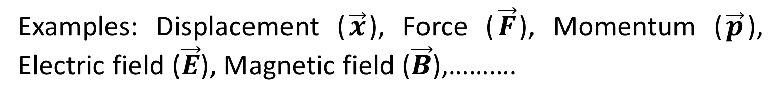
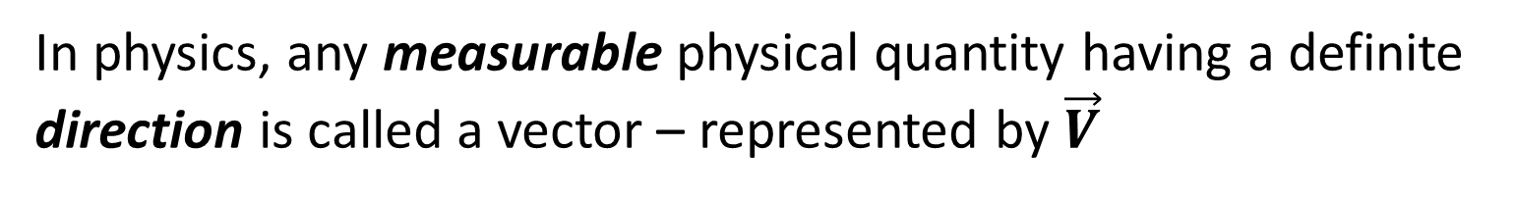
What are vectors?
In physics, any measurable physical quantity having a definite direction is called a vector – represented by $\vec{V}$
(crude definition)
Examples: Displacement ($\vec{x}$), Force ($\vec{F}$), Momentum ($\vec{p}$), Electric field ($\vec{E}$), Magnetic field ($\vec{B}$),……….
Many algebraic operations can be performed on vectors such as addition, subtraction, multiplication just like mathematical numbers
In physics, there are two interesting operations involving vectors. They are Dot Product and Cross Product (already completed in PHY101)

Slide 21
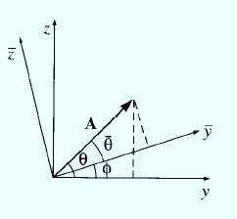
A physicist’s definition of vector
Any set of three components which combines properly on addition and transforms according to a specific transformation law from one frame of reference (coordinate axes) to another
Notes:
Components of A in (x-y-z) frame of reference changes, not in an arbitrary manner but under a specific transformation law, when you change the co-ordinate axes to $\overline{x},\overline{y},\overline{z}$

Slide 22
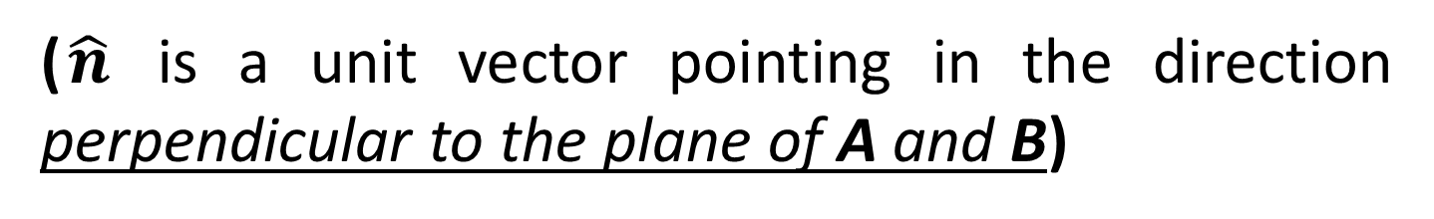

Cross product of two vectors
The cross product of two vectors is defined by
$$A×B=ABsinθ\hat{n}$$
($\hat{n}$ is a unit vector pointing in the direction perpendicular to the plane of A and B)
Ambiguity: There are two directions perpendicular to any given plane – either pointing ‘in’ the plane or pointing ‘out’ of plane

Slide 23
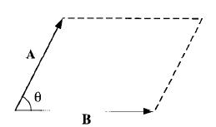
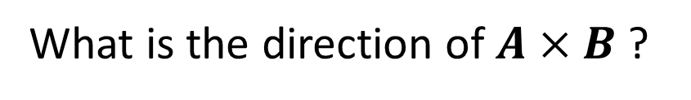
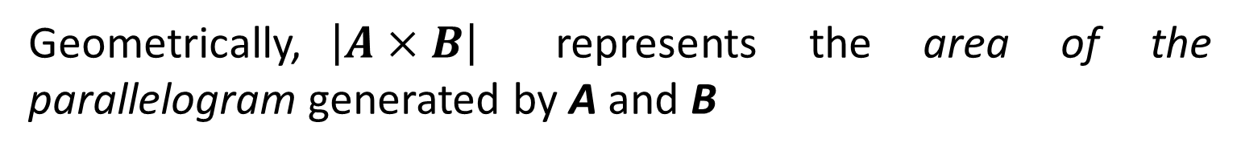
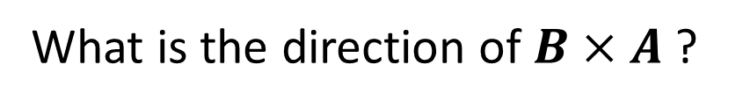
Cross product of two vectors
Right hand rule: Imagine you are rotating a screw in a direction from the first vector to the second (two vectors having a common origin) via the smaller angle- direction of the screw would give you the direction of the cross product.
What is the direction of $A×B$ ?
What is the direction of $B×A$ ?
Geometrically,$\left|A×B\right|$ represents the area of the parallelogram generated by A and B

Slide 24
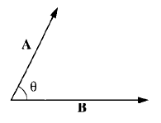



Dot product of two vectors
The dot product of two vectors is given by
$$A∙B=ABcosθ$$
Dot product is a scalar quantity (hence it is also called a scalar product)
Geometrically, A.B is the product of A times the projection of B along A (or the product of B times the projection of A along B)
If two vectors are parallel, then
$$A∙B=AB$$
If two vectors are perpendicular, then
$$A∙B=0$$

Slide 25
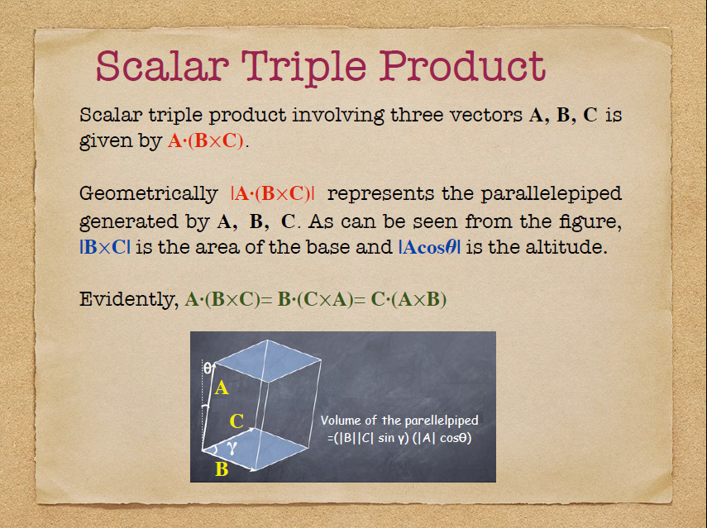

Slide 26
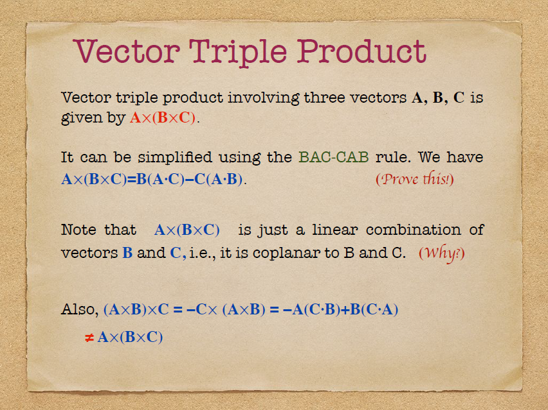

Slide 27
